Slide 1
Design with Accessibility in Mind
CSCI 185
Spring, 2023

Slide 2
Outline
Announcements
Tutorial 6 preview
Design with Accessibility in Mind (with help from Victoria Chávez)

Slide 3
Outline
Announcements
Tutorial 6 preview
Design with Accessibility in Mind (with help from Victoria Chávez)

Slide 4
Announcements
HW4 due tonight
I have Office Hours today (3:30-4:30PM) for any last-minute questions about the homework
HW5 Posted (last homework before the break)
Tutorial this Friday – styling your homepage
Next two weeks:
Today’s lecture: Design + accessibility
Wednesday + next week: advanced CSS techniques and transitions

Slide 5
Outline
Announcements
Tutorial 6 preview
Design with Accessibility in Mind (with help from Victoria Chávez)

Slide 6
Tutorial 6 Preview
Refer to your sources of inspiration (think about what you like)
How might you draw inspiration from the examples you found (e.g. alignment, contrast, proximity, color, typography, textures, images, etc.) to communicate your unique personality?
Pick some values you want to visually communicate about yourself. How can you best express your personality?
Things to consider: composition, color choices, responsive design, accessibility, and your personal style

Slide 7
Outline
Announcements
Tutorial 6 preview
Design with Accessibility in Mind (with help from Victoria Chávez)

Slide 8
“The power of the Web is in its universality. Access by everyone regardless of disability is an essential aspect.”
- Tim Berners-Lee, W3C Director, inventor of the Web
Notes:
So, this is a quote by Tim Berners-Lee, the inventor of the world wide web and current director of W3C, which is the web standards board
He says "The power of the Web is in its universality. Access by everyone regardless of disability is an essential aspect.”
Now, this is a very powerful concept and it’s one that I want you to keep in mind as we go through this lecture.
The original idea for the internet was that it should act as a tool for anyone to be able to access information about, well, anything
What Tim is saying here is that that mission collapses when we don’t consider accessibility in our designs, as the internet is no longer universal

Slide 9
Accessibility Is Very Important
15% of the world population and 26% of the U.S. population has a some form of a disability
Statistically: about 3-4 people in this class
Most of us will become disabled at some point (temporary or permanently)
Usually by way of injury or age-related health conditions
Inaccessibility is illegal
New legal precedent: ADA (Americans with Disabilities Act) applies to websites Domino’s Pizza ruling – see course-website/course-files/readings/accessibility/dominos reading).
Credit: Victoria Chávez
Notes:
Source: CDC Disability Impacts All of Us

Slide 10
Design with accessibility in mind
How do I design my website so that it…
Is easy to use?
Is pleasant to look at?
Does not leave user confused?
Serves its purpose (to sell, inform, catch someone’s attention, etc.)?
Is accessible to everyone?
Credit: Victoria Chávez

Slide 11
So, what can you do to make your website accessible?

Slide 12
1. Consider how various forms of disability might impact a person’s experience of your website.
Take a look at these accessibility posters.
What implications might these suggestions have for the website you want to build?
Many (but not all) of these suggestions map onto the principles of design that we discussed last week.
Credit: Victoria Chávez

Slide 13
2. Follow the rules of composition
Poor use of proximity may prevent neurodiverse users from easily navigating your site. It can also prevent screen-readers from properly reading a site aloud for blind users
Low or bad contrast prevents color-blind users and low-vision users from accessing your site
Use lightness to create contrast, not just hue
Avoid complementary hues (e.g. red and green, orange and blue) and bright colors for backgrounds.
Misaligned sections (alignment) can be confusing and make it difficult for users with mobility issues to access your site
Credit: Victoria Chávez
Notes:
9/11, end by 1:15

Slide 14
…but, good design is not necessarily accessible
While bad design is inaccessible, accessibility is more than just good design
Other accessibility considerations include:
Descriptive alt-text and captions for media
Resizable-friendly
Screen-reader friendly
Keyboard-friendly (no mouse)
There’s actually a whole set of standards for web accessibility: Web Content Accessibility Guidelines (WCAG)
Fret not, plenty of accessibility resources are available to help you get started!
Credit: Victoria Chávez
Notes:
11/11, end by 1:15

Slide 15
3. Consider Content & Structure (beyond the CSS)
Use semantic HTML
Describe tables, graphs, and figures
Write in plain, simple, concise language
Describe images using the alt attribute of the img tag
Always set the language of a webpage (i.e., <html lang="en">)
Use descriptive links (i.e., “accessibility resources”, not “more info here”)
Credit: Victoria Chávez

Slide 16
A few quick notes on color blindness

Slide 17
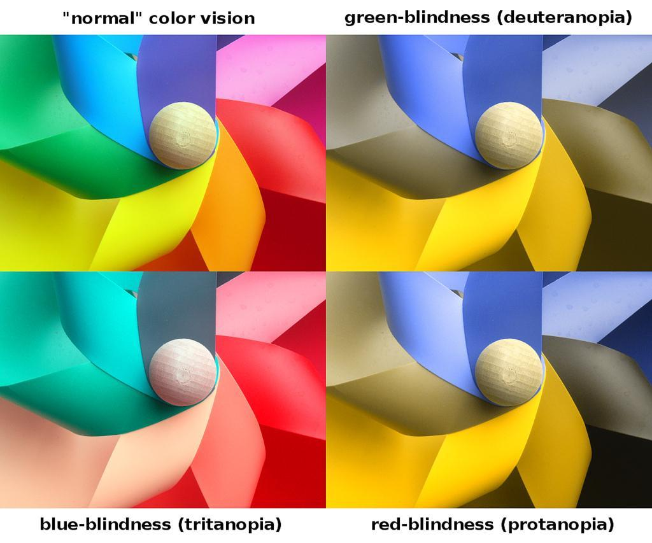
Color Blindness
http://www.w3.org/WAI/ER/tools/
Test for color blind users
Maintain contrast - http://contrastrebellion.com/
Wave plugin also works!
Notes:
There are three different kinds of color deficiency:
Red-blindness (lower right) is reduced sensitivity to red-green differences
reds are perceived as darker than normal
Green-blindness (upper right) is a reduced sensitive to red-green differences
but reds do not appear darker
Blue-blindness (lower left) is a reduce sensitive to blue-yellow differences

Slide 18
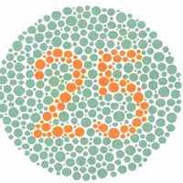
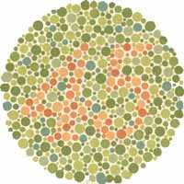
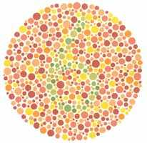
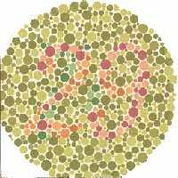
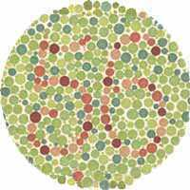
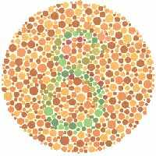
Color Blindness: Ishihara Plates
Notes:
One of the most common ways to detect colorblindness is using the Ishihara plates.
Let’s look at a few
Can you see the numbers hidden in each of the circles?
These test red-green colorblindness.
If you’re colorblind, you can’t see the bottom of the left pair, the top of the middle pair, and neither of the right pair.

Slide 19
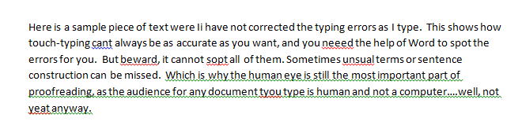

Color Blindness Guidelines
Notes:
Guidelines for designing websites that are usable for colorblind people:
Chose colorblind-safe color palettes – colors that are distinguishable by everyone
Don’t depend only on color distinctions, especially red-green, for conveying information
A lot of commercial apps fail to follow these guidelines
One example – Microsoft Office applications
Use red lines to indicate spelling errors and green lines to indicate grammar errors
Indistinguishable if you have red/green colorblindness
Another example – traffic lights
How do red-green color-blind people know whether the light is green or red?
There’s a spatial cue: red is always above (or to the right of) green

Slide 20
Use accessibility tools to help you

Slide 21
Demo: Using the WAVE Browser Extension
One useful tool you might consider:
Install the WAVE browser extension here
Let’s try installing it before doing an accessibility analysis…

Slide 22
Let’s Explore Accessibility
Pick a site you use often to conduct a design and accessibility review on it, and check out the accessibility resources on the course site (under “Web Reference”)
Consider the following questions:
Does the site have good design? Why / why not?
How accessible is the site:
Can you navigate without a mouse?
What does the WAVE report say?
Do they make good use of semantic tags?
How could you improve it?
How do comparable sites do a better or worse job with regard to accessibility?
Credit: Victoria Chávez
Notes:
End by 1:30

Slide 23
Share Out
What stood out from the activity?
Questions / thoughts / comments / concerns?
Your thoughts here…

